Slide 1
The Gabelli School
at a Glance

Slide 2
Welcome!
Today we will discuss:
Goals of the Gabelli School
Team who will support you
Core Curriculum Basics
Programmatic Opportunities
Personal and Professional Development

Slide 3
Goal: Develop business leaders
The Gabelli School of Business program is designed specifically to cultivate business leaders.
A business leader is someone who can:
Be an innovative critical thinker
Analyze a situation quickly and effectively
Find original solutions to problems
Work well in teams
Handle “strategic ambiguity”
Clearly communicate ideas in a way that will inspire others
Lead with Purpose
Corporate social responsibility
Public service, local and international
Volunteerism
Support for current students and fellow alumni

Slide 4
Four main areas of focus
We hold ourselves each year to raising the bar ever higher in four areas:
Academic excellence
Global perspective
Student personal and professional development
Innovation and excellence in teaching

Slide 5
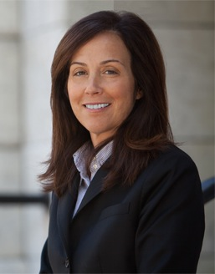
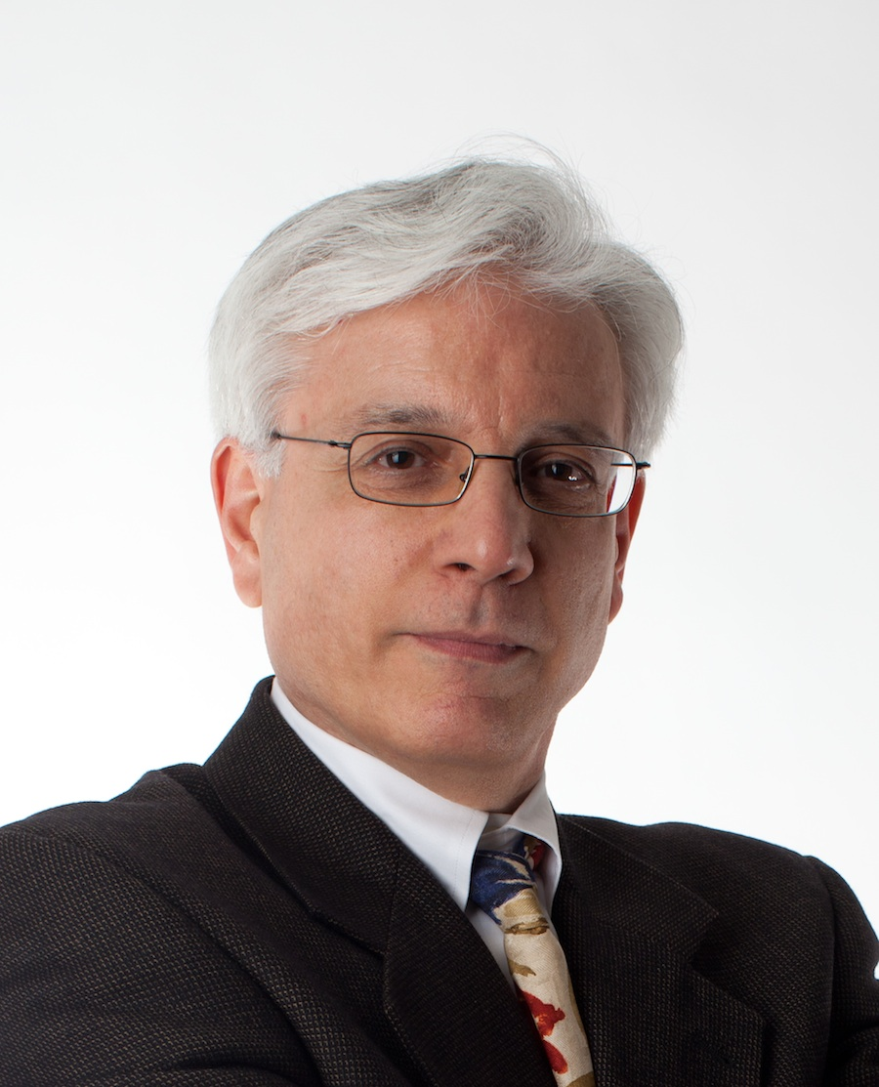
Leadership
Donna Rapaccioli
Harry Kavros
Dean
Associate Academic Dean
Ph.D., M.S., Accounting
New York University
B.S., Accounting
Fordham University
Also serves as Dean of Faculty for both undergraduate and graduate business schools at Fordham
Ph.D., English
University of California, Berkeley
B.A., English
Haverford College
Responsible for ensuring that the Gabelli program educates students in both business and liberal arts

Slide 6
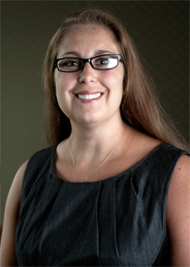
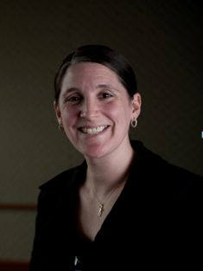
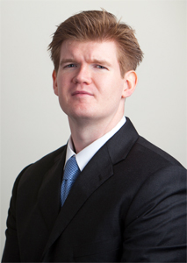
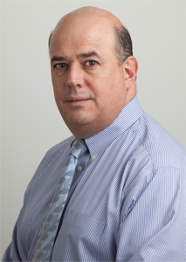
Academic Advisors
Greer Jason-DiBartolo
Freshmen
Gabriella Brown
Sophomores
Alan Cafferkey
Juniors
Mario DiFiore
Seniors
Different advisor and advising structure each year
Help with: registration, course selection, grades, academic planning, absences, etc.
Freshman year:
Mandatory advising meetings, 5x per semester, grade P/F
Individual meetings with Dean Jason as needed
Required meetings if GPA <2.0 at midterm or end of term
Advising Assistants: Upperclass students provide advice & mentoring

Slide 7
Academic Excellence

Slide 8
Our new academic center: Hughes Hall
The renovation will leave the building’s external shell intact but replace the interior with a state-of-the-art business learning environment.
Selected features
Smart technology-equipped classrooms
State-of-the-art Information and Media Technology Center
144-seat auditorium
Space for classes, networking events and special learning exercises
Multiple common areas and conference rooms
All business faculty offices in one cohesive location

Slide 9
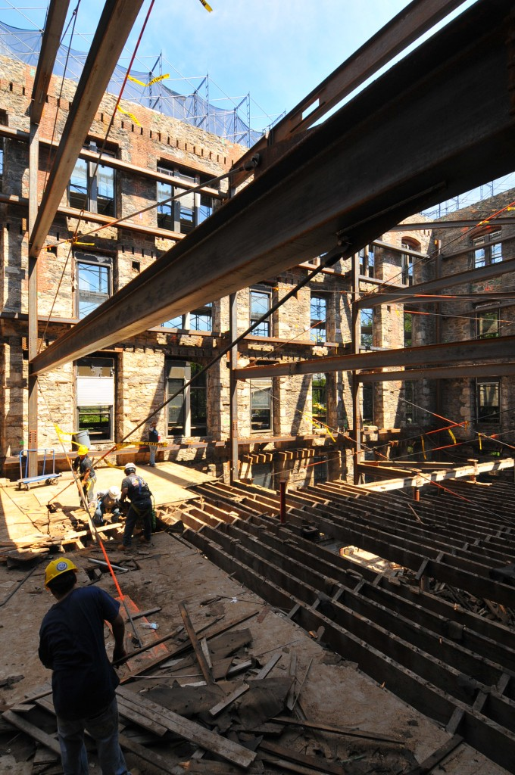
Hughes Hall

Slide 10
Gabelli at a glance: Class of 2016
Freshman class enrollment: 423
Average SAT score: 1265
International students: 9%
Countries represented:
China
Colombia
France
Guatemala
Hong Kong
India
Indonesia
Italy
Japan
Mexico
Philippines
Singapore
Switzerland
Taiwan
Venezuela

Slide 11
Graduation Requirements
40 Classes, each at least 3 credits
120 Credits
Note: Students intending for CPA need 150 credits
5 classes/15 credits per semester
Course Structure:
Dual Core Curriculum
Liberal Arts Core
Integrated Business Core
Major Classes
Electives
Coming with Credits?
AP Credits
Need 4 or 5 on AP exam to receive credit
May place out of Calculus, Microeconomics, Macroeconomics
All other courses will fulfill liberal arts electives
College Credit
Must have been on a college campus, taught by a college professor, with other college students, and with a minimum grade requirement to be considered

Slide 12
Degrees and majors
Degree awarded: Bachelor of Science
Majors:
Applied Accounting and Finance
Accounting Information Systems
Business Administration
Finance
Information and Communications Systems
Marketing
Public Accounting
Business Administration, with a concentration in:
Students choose a major in spring Sophomore or fall Junior year.
Accounting
Business Economics
Entrepreneurship
Finance
Information and Communications Systems
Marketing
Management

Slide 13
Minors and Specializations
Minors:
Gabelli School of Business
Accounting
Economics
Law & Ethics
Fordham College at Rose Hill
Multiple Options
Foreign Language often completed
Joint College
Sustainability
Specializations:
Communications and Media Management
GLOBE

Slide 14
Why two core curricula?
We believe business students must have a solid grounding in the liberal arts to be successful business leaders.
This includes:
Familiarity with great philosophical thinkers
Understanding of history and historical context
Coursework in theology
Writing and presentation skills
Ability to think critically and break down complex problems

Slide 15
Liberal Arts Core Requirements
Economics: Basic Macroeconomics
Basic Microeconomics
Statistics I
English: Composition II
Text & Context: Advanced English course
Fine Arts: Any fine arts elective
History: One “Understanding Historical Change” course
Mathematics: Math Methods: Finite
Math Methods: Calculus
Philosophy: Philosophy of Human Nature
Philosophical Ethics
Theology: Faith and Critical Reason
Sacred Texts: Advanced Theology course

Slide 16
The Integrated Business Core
Business Core Curriculum Requirements
Ground Floor **Only FR course
Financial Accounting
Managerial Accounting
Marketing Principles
Information Systems
Business Communication
Strategy
Principles of Management
Statistical Decision Making
Legal Frameworks of Business
Ethics in Business
Financial Management
Integrated Projects (4)
Each course incorporates 12 “threads”:
Analytical skills
Career planning
Discernment/self-awareness
Entrepreneurial thinking
Ethics
Global perspective
Integrated business thought
Leadership
Presentation skills
Teamwork
Technology
Writing/literacy

Slide 17
Typical Freshman Year Schedule
Gabelli freshmen will take one of these courses first semester and one second semester:
Ground Floor* & Composition II*
Exception: Students who need ESL or Composition I will take ESL or Composition I in Fall and BOTH Ground Floor and Composition I or II in Spring
Basic Macroeconomics* & Basic Microeconomics*
Math for Business: Finite* & Math for Business: Calculus*
Exception: Students who need Pre-Calculus will take Pre-Calculus in Fall and Math for Business: Calculus in Spring
Philosophy of Human Nature & Faith and Critical Reasoning
Fifth Course each semester:
Foreign Language (optional for Gabelli, required for GLOBE, note preference on registration questionnaire)
Upper level Liberal Arts Requirement
Liberal Arts Elective
History (recommend do not take FR year if intend to study abroad)
Fine Art (recommend do not take FR year if intend to study abroad)
Statistics
*REQUIRED COURSE PRIOR TO SOPHOMORE YEAR INTEGRATED BUSINESS CURRICULUM
**STUDENTS WILL BE REGISTERED BY THE UNIVERSITY FOR FRESHMAN FALL COURSES; GABELLI STUDENTS NOTIFIED VIA FORDHAM EMAIL WHEN STUDENTS ARE AVAILABLE A FEW DAYS PRIOR TO ORIENTATION

Slide 18
The Ground Floor
About the course:
Introduces fundamentals of accounting, finance, marketing, etc.
Students work in teams to propose a business of their own creation
Assignments are graded twice: once by a business professor to assess a student’s grasp of business fundamentals, and then again by an English professor to evaluate writing mechanics, composition and style
Course goals:
Understanding of all business disciplines
Development of writing, verbal presentation, and critical thinking skills
Practice working in teams
Learning to think “entrepreneurially”
Familiarity with New York City, via assignments that require students to explore the local area

Slide 19
Academic Support Options
A number of departments and services are available to aid students in their transition from high school to college:
Tutoring Centers
Writing Center
Economics Help Room
Math Help Room
Gabelli Study Center
Martyrs’ Court Jogues Manresa Program tutors
Individual Departmental Tutoring
Office of Disability Services
Accommodations for students with disabilities
Academic coaching for all students
Counseling and Psychological Services and Campus Ministry
Assistance for students having difficult adjusting to college
Individual Advising Appointments with Gabelli Deans and Staff
Professor Office Hours

Slide 20
Frequently Accessed Programmatic Opportunities

Slide 21
What is a “global opportunity”?
At Fordham, these can happen …
In New York:
Global aspect to all Gabelli coursework
Internships at Manhattan offices of multinational firms
Opportunities at governmental and nongovernmental organizations with international reach (United Nations, NYSE/Euronext, etc.)
Abroad:
Full semesters abroad (fall, spring, summer)
Gabelli London Centre (fall, spring, and summer)
Partnerships with other colleges and universities across the globe
International study tours (one week or two weeks)
Internships in other countries

Slide 22
The G.L.O.B.E. program
Gabelli’s international specialization
Students select a country of focus
Three required courses: two global business, one cultural studies
Language proficiency, second intermediate level
Must study abroad or complete a globally focused internship
Statistics
Program launched 1992
In the Class of 2011, 155 students (about 25% of the graduating class) earned the G.L.O.B.E. specialization

Slide 23
Dual-degree programs
About the programs
High-achieving students earn a bachelor’s and master’s degree in 5 years total
Undergraduate Gabelli experience remains the same
After earning the B.S. degree, students move on to Fordham’s Graduate School of Business administration for an M.B.A. or M.S.
Multiple combinations of degrees and majors/concentrations are available
Requirements for students
Application in junior or senior year
Strong grades in business and liberal arts courses
High score on GMAT
Internship experience
Commitment to active involvement in student life (campus activities, professional societies, extracurricular pursuits)

Slide 24
Personal and
Professional Development

Slide 25
A commitment to students that goes beyond academics
Four-year personal and professional development track:
Personal development:
Self-discovery and self-awareness
Character building / values education
Cura Personalis: Care for the whole person
Homines pro aliis: Men and Women for and with others
Unity of Heart and Mind: Connecting the intellect with values
Magis: Constantly striving to do better
Professional development:
Career-search skills
Networking and mentoring opportunities
The Fordham alumni network

Slide 26
Personal development: IGNITE
This four-year framework is incorporated into all out-of-classroom Gabelli initiatives. It aims to guide students to discover their strengths, weaknesses and preferences, increasing their overall self-awareness in a way that will last.
Programs, events, activities, and advising sessions will encourage students to…
Cultivate a sense of exploration
Engage in reflective thinking
Practice ethical decision-making
Reinforce the themes of a Fordham education:
Goals each year of study:
Intellectual excellence
Respect for others
Appreciation of diversity
Moral leadership
Freshmen: Self-Awareness
Sophomores: Ingenuity
Juniors: Passion
Seniors: Heroism

Slide 27
Personal development: Service
Gabelli School of Business students learn the importance of being “men and women for and with others.”
They demonstrate this principle by volunteering through dozens of Fordham University social justice and community service programs, including:
Freshman Year:
Urban Plunge
Service Learning
Multiple Justice Opportunities
Later Years:
Fair Trade Consulting Program
NYC Consulting Program

Slide 28
Professional development: Doesn’t career services do that?
Yes, but we supplement the university’s offerings in a way designed specifically to advance the careers of business students.
Heather Krasna
Director of Personal and Professional Development
Nancy McCarthy
Manager of Personal and Professional Development
Oversee:
Employer relationship building
Career discovery events
On-campus gatherings with executives
Small group student/alumni networking dinners
Interview practice sessions
. . . and much more.

Slide 29
Three sector mentors: Accounting, Finance, Marketing
Tara Naughton
Accounting
Example program:
Working directly with highly motivated students in organizations such as Beta Alpha Psi, Smart Woman Securities and ALPFA to advance their career objectives.
Lisa Henkoff
Finance
Example program:
One-on-one meetings with sophomore, junior and senior finance majors, followed by personal advocacy on students’ behalf with known recruiters at firms
Gina Hill-Lobasso
Marketing
Example program:
Marketing practitioner sessions where students meet executives and recruiters by helping them problem-solve an actual challenge faced by the company
All three sector mentors provide:
Career coaching: résumé writing, interviewing
Discipline specific events and conferences
Networking opportunities with industry professionals

Slide 30
Career and internship statistics
90% of Gabelli students typically hold one or more internships while in college.
77% of students in the Class of 2011 who obtained full-time jobs reported that an internship led directly to the permanent position.
82% of the Class of 2012 had landed full-time jobs or secured spots in graduate programs within one month of graduation or had enrolled in graduate or professional school programs.
Note: Freshmen are not permitted to have internships.

Slide 31
Where do students and alumni work?
A few examples from among hundreds of organizations:
On Campus Recruiting
Fordham has ties with 2,600+ firms
U.S. News & World Report ranks Fordham 5th nationwide in universities producing the most interns
Average 2010 Gabelli School of Business starting salary: $57,806
ABC TV
Bank of America
Barclays Bank
BBDO
Citigroup
Credit Suisse
Deloitte
Ernst & Young
GE
Goldman Sachs
IBM
JPMorgan Chase
KPMG
McCann Erickson
Michael Kors
MTV
New York Yankees
PepsiCo
PwC
Tiffany & Co.

Slide 32
Frequently
Asked
Questions

Slide 33
What are answers to frequent questions?
What are some important orientation dates?
The first day of the three day mandatory orientation is Sunday, August 26th for both commuters and residents.
Monday, August 27th is Academic Orientation.
The first day of classes is Wednesday, August 29th.
How can I stay connected to the Gabelli School, both before arrival and after I start classes?
Read your summer book, to be announced soon!
Gabelli Class of 2016 Facebook Page
www.fordham.edu/gsb
www.gabelliconnect.com & www.gsb-access.com**
www.twitter.com/fordhamgsb
Free WSJ access**
**Will receive access after arrival

Slide 34
What are answers to frequent questions?
I’m not in Gabelli, but I would like to be/am supposed to be?
Contact the Office of Admission, specifically, the person listed on your letter of acceptance.
When should I buy my books?
After the semester begins, you will receive a syllabus from each professor. At that time you will know what books to purchase. If you buy online, be sure they will arrive quickly!
Should I buy a computer? If so, what kind should I get?
This is a personal choice. If you do choose to buy a computer, we recommend that you follow the University guidelines. If not, there are plenty of computer labs on campus. The Class of 2015 was required to purchase laptop computers for SO year, so you may be required to do the same. PCs with Office 2010 will likely be required.

